Slide 1

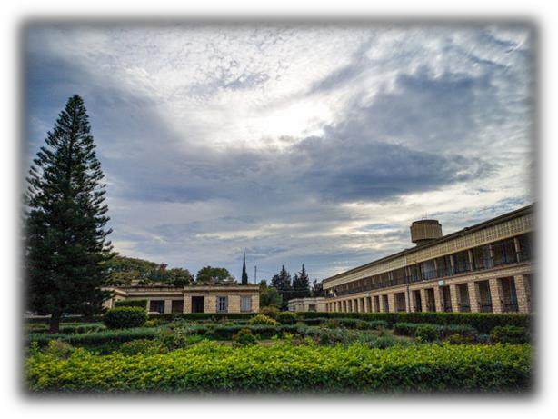
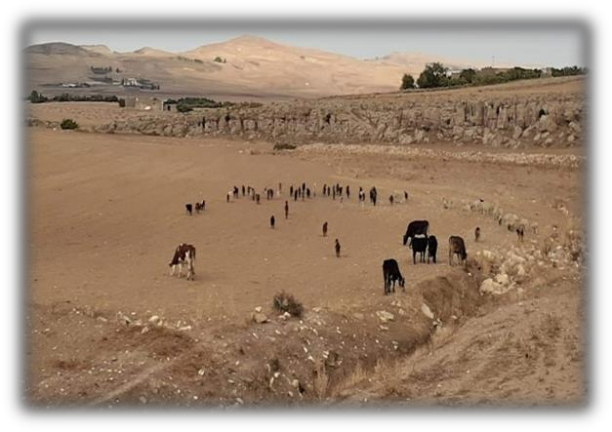
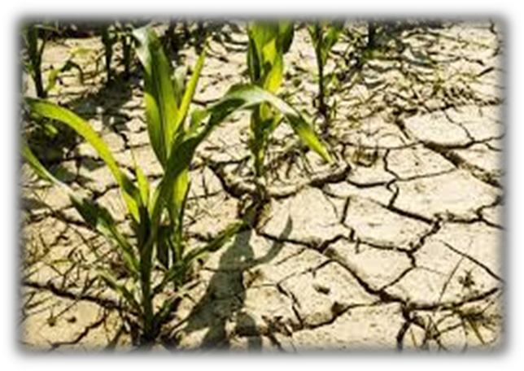
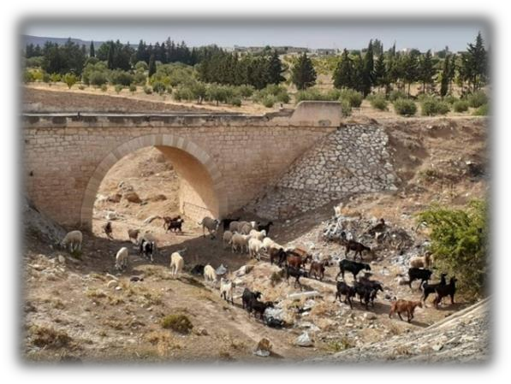






8th International Conference
Integrated Natural Resource Management and Sustainable Agriculture March 8-10, 2023
Golden Tulip Taj Sultan Hotel, Hammamet - Tunisia
Organized By the Higher School of Agriculture, Mograne in partnership with
ICARDA
Call for Abstracts
The global socio-political crisis and the continued economic effects of the COVID-19 pandemic conjugated with the accentuated impact of climate change are negatively affecting food production and distribution systems worldwide. This challenging context, poses a considerable threat to global food security, with potentially existential economic, political, and social outcomes for humanity. Agricultural sector became under various driving forces to meet sustainable intensification and major adjustments are needed. A set of mutually interlinked technical, institutional, and social factors are driving resources degradation thus leading to declining agriculture production, low mitigation and adaptation to climate change, disproportionate fall in biodiversity, increasing scarcity of water resources and soil erosion, and higher pressure on land use. In addition to structural problems related to finite stocks and management patterns of natural resources, further challenges of the agricultural sector are related to its low productivity, low added value, absence of advanced management tools and practices, absence of marketing and supply chains strategies, lack of extension services and appropriate approaches of technology transfer. In this regard, the Higher School of Agriculture of Mograne (ESA Mograne) organizes in partnership with ICARDA the eighth international conference on Integrated Natural Resource Management and Sustainable Agriculture, a user-friendly framework for contributing to the current scientific debate and exchanging experiences and scientific thoughts about the major trends and problems of transitioning the Tunisian agriculture towards sustainable intensification models. Due to the global aspect of the themes addressed, the target audience extends to the national and
Themes
Integrated management of natural resources and food security
Integrated Pest Management
Agricultural policies and rural development
Resilience of agroecosystems
Governance and territorial management
Social and solidarity economy
Agro-industrial value chain
Biodiversity and conservation of genetic resources
Smart and digital agriculture
Family farming and agroecological practices
Agriculture and energy efficiency
Integrated Pest Management
Animal health and plant biotechnology
Livestock and rangelands
Applied remote sensing and GIS
Education, research, extension, support and agricultural innovation
international scientific community.
Important Dates
Abstract submission : January 31, 2023
Acceptance notification: February 10, 2023
Registration: March 1, 2023
Registration Fees
Professors-researchers and professionals: 400 TND
Students: 200 TND
international Participants: 200 EUROS
Online participation: 50 EUROS
Scientific Committee
Slim Rouz (ESAMo)
Ghzel Lamia (ESAMo)
Slim Zekri (SQU,Oman)
Abdallah Benalaya (Tunisia)
Ali Abaab (GIZ, Tunisia) Akari Abdallah (FSEGT) Andreas Thiel (Germany) Kaouther Lajili (Canada) Hajer Ammar (ESAMo) Ghazi krida (INAT)
Jouda Mediouni (INRAT)
Aymen Frija (ICARDA)
Boubaker Dhehibi (ICARDA) Veronique Alary (ICARDA)
Nicolas Faysee (CIRAD)
Zayani Khemaies (AVFA )
Mongi Ben Younes (PRRDA) Bayrem Jammeli (ESA Mateur) Tibaoui Gouider (ESA Mateur) Ben jeddi Fayçal (INA Tunisia) Taha Najar (INAT)
Moujahed Nizar (INAT)
Sanaa Mustapha (INAT)
Harrabi Moncef (INAT)
Tarhouni Jamila (INAT)
Ben Hassine Habib (Tunisia)
Sinan Bacha (CNCT)
Ahmed Ezzine (CNCT) Thouraya Sahli (CNCT)
Youssef Fouad (France) Moncef Bouaziz (Allemagne) Eric Conti (UNIPG, Italy)
Jesus M. Castillo (US, Spain) Fabio Primavera (USP, Italy)
Angela Canale ( Italy)
Franco Cotana (USP, Italy)
Anouar Ben Mimoun (INAT)
Mohamed Abdeladhim (ESAMo) Ayoub Fouzai (ESAMo)
Hassen Abdelhafidh (ESAMo) Lasaad Albouchi (ESAMo) Salem ben Hassen (ESAMo) Samir ben Ali (ESAMo) Mohamed Elimem (ESAMo) Emna Ouertani (ESAMo) Hamouda Aichi (ESAMo)
Ben Hassine Kaouther (ESAMo) Manel Mosbahi (ESAMo)
Amel Kerkeni (ESAMo)
Publication
Authors with selected articles are invited to submit their papers in accordance with a template that can be downloaded from the ESA Mograne website. Selected papers will be published in the conference proceedings.
Side events
The organizers are planning a series of activities alongside the "Side events" and a "poster presentation" session.
Conference E-mail
girnad2023@gmail.com

